Slide 1
Working with the Operating System

Slide 2
os
fs
child_process

Slide 3
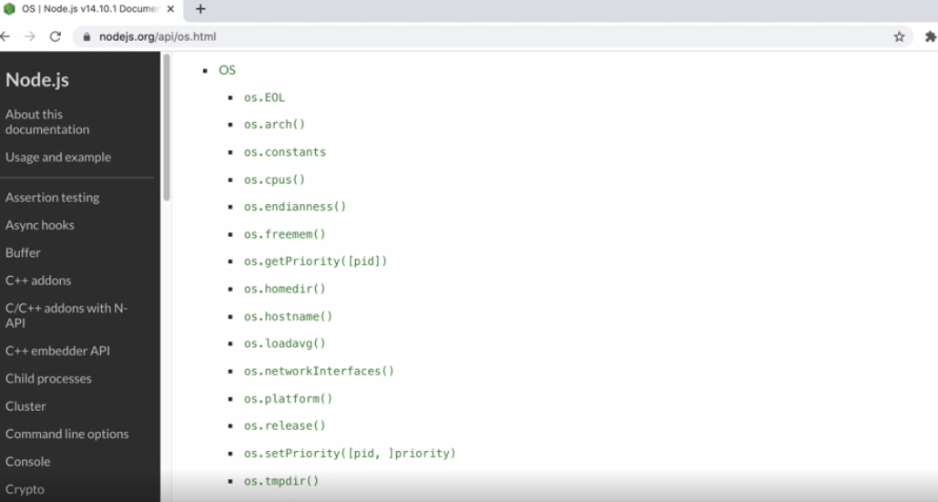

Slide 4
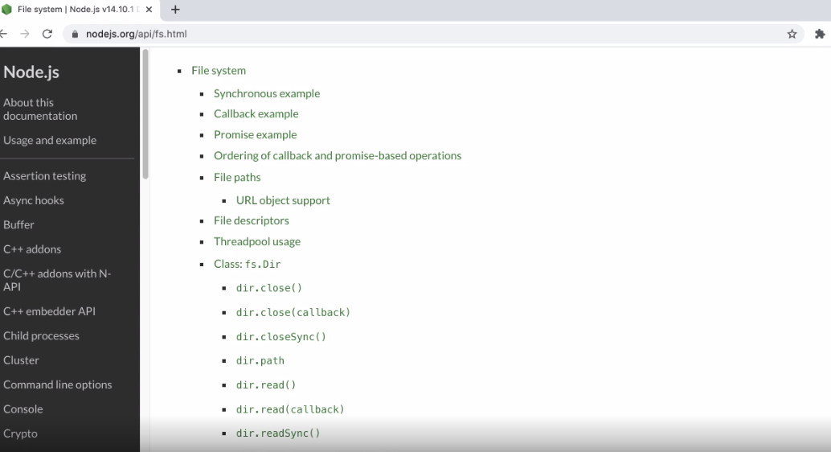

Slide 5
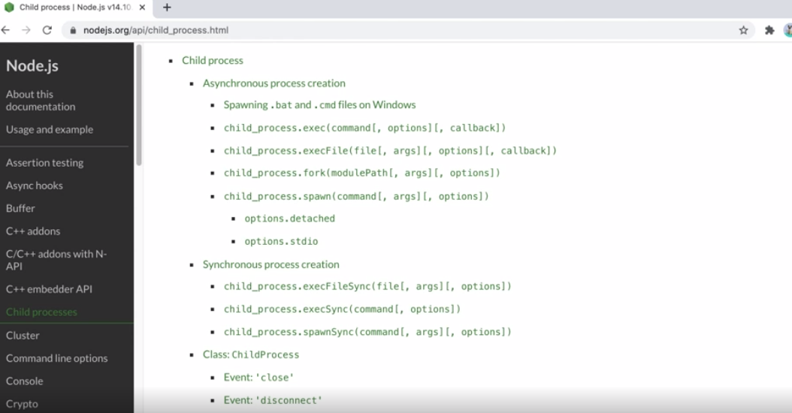

Slide 6
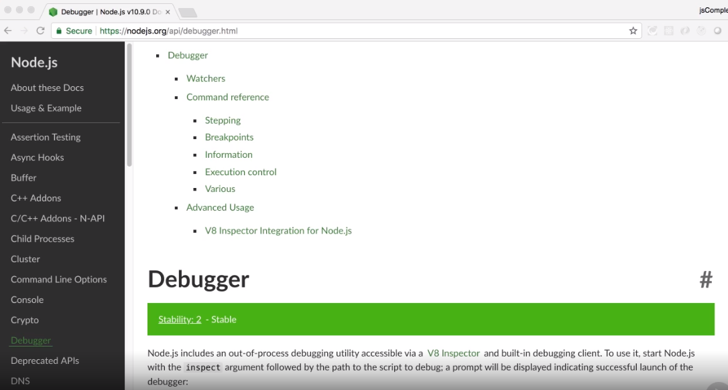

Slide 7
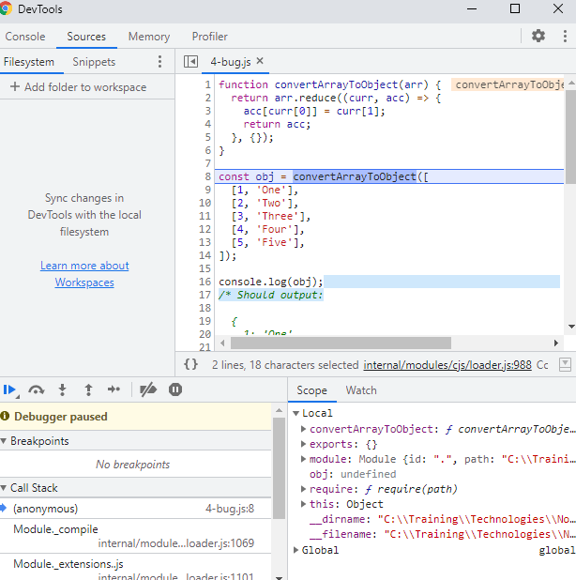

Slide 8
Wrap Up
The os module
The fs module
The child_process module Debugging with Chrome DevTools

Slide 9
Questions?

